Slide 1


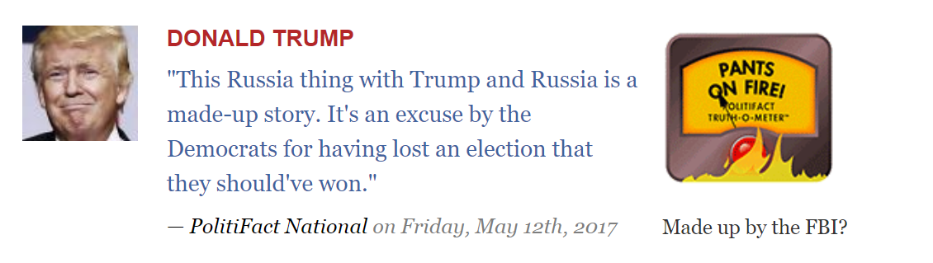

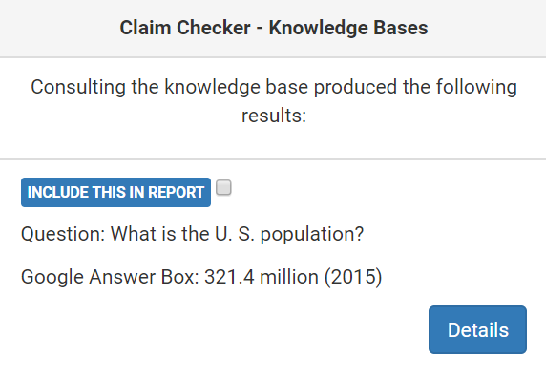
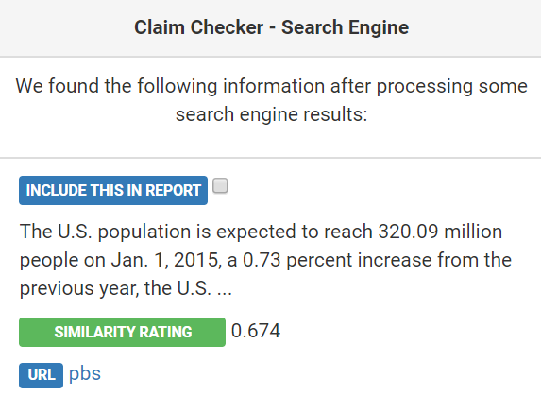
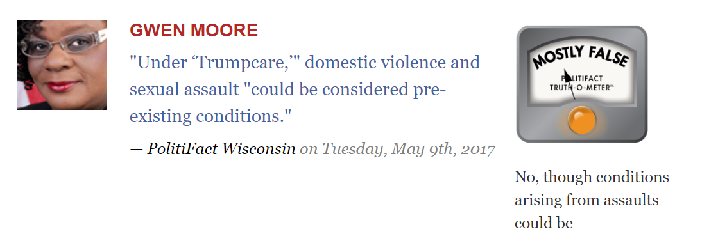
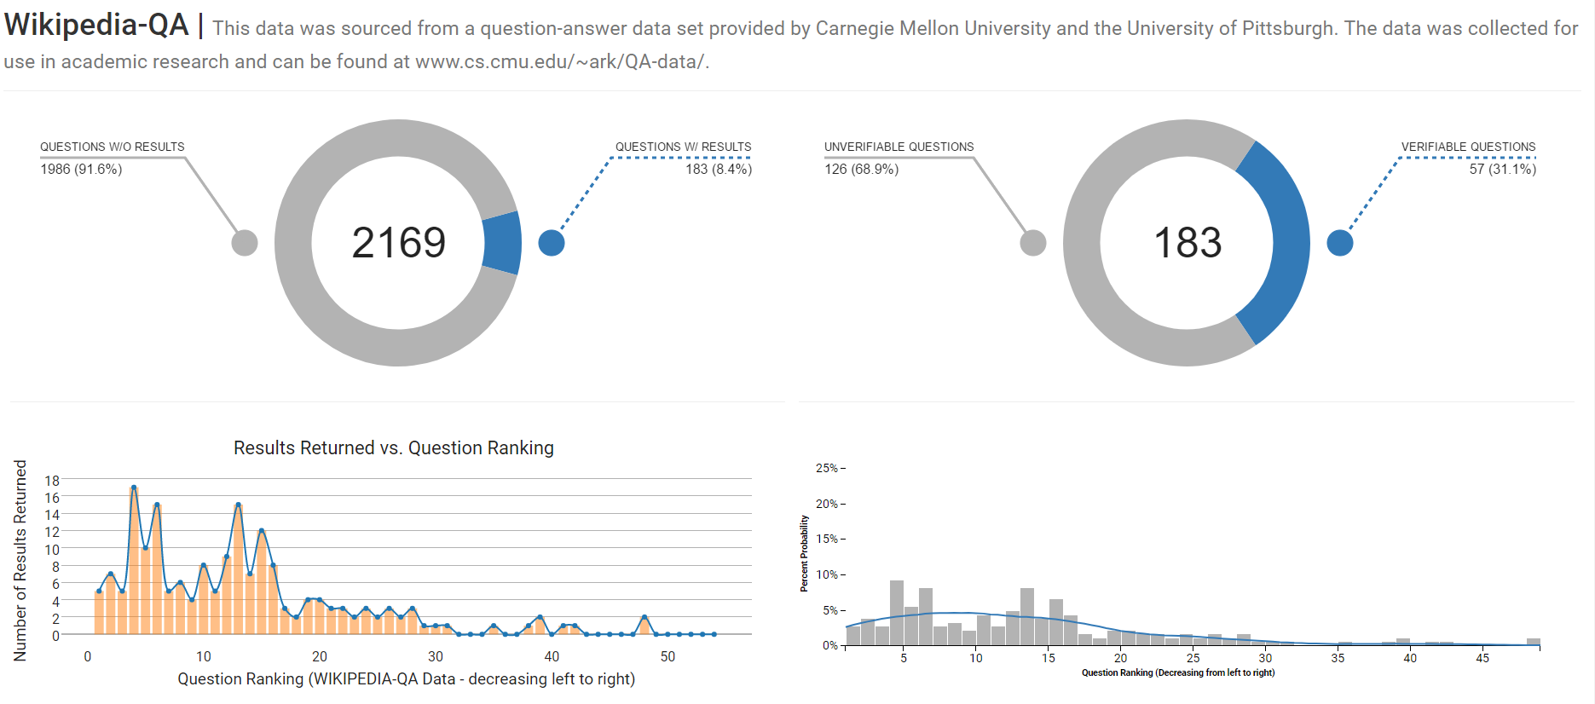
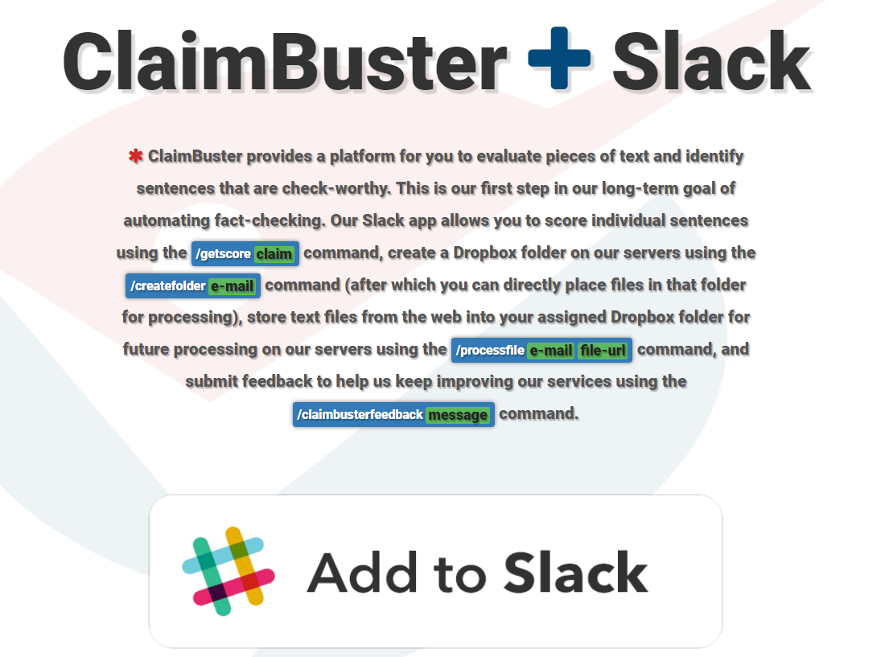
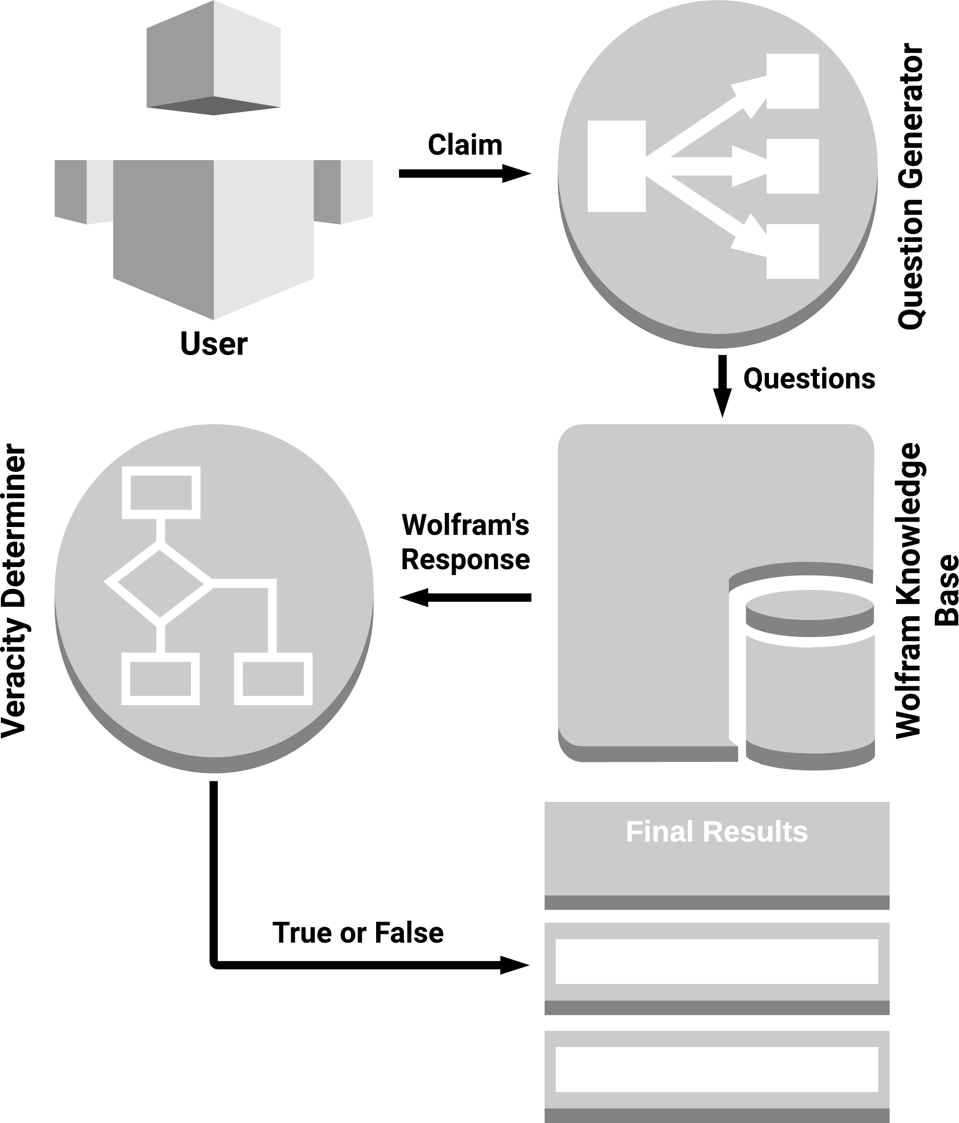
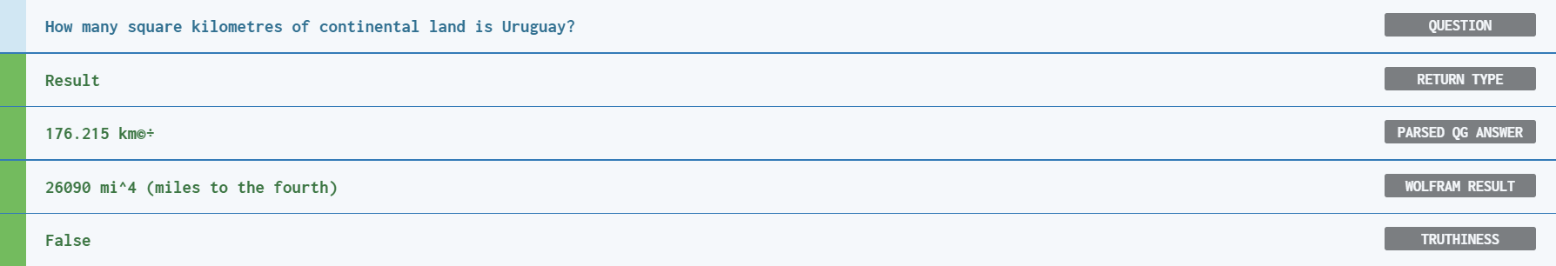
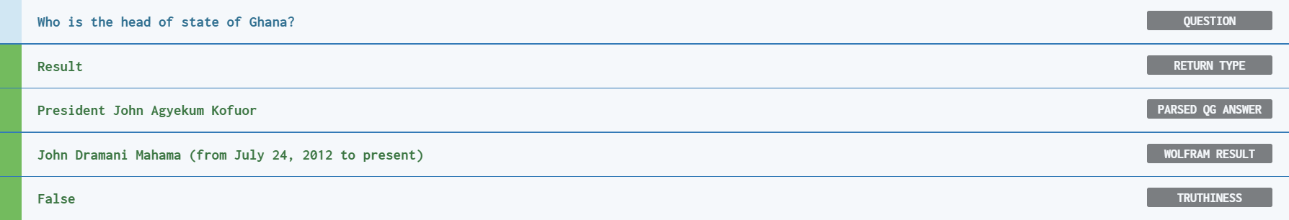
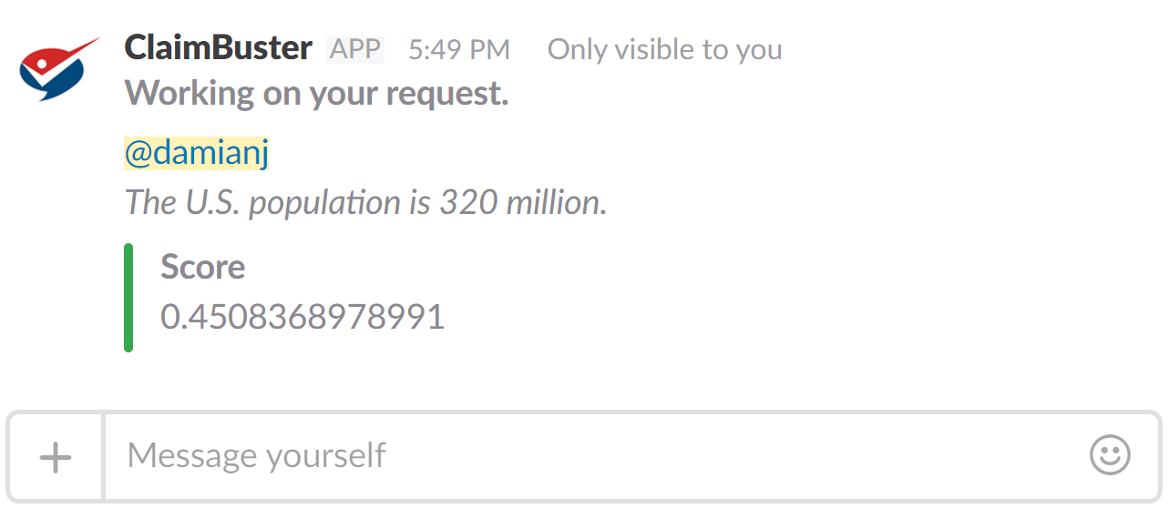
Towards Building an Automated Fact-Checking System
iDIR
The Innovative Database and Information Systems Research Laboratory (IDIR)
Damian Jimenez | Chengkai Li (Supervisor)
Motivation
objectives
Strides FORWARD
{
Assess the limitations of current technologies
idir-server2.uta.edu/factchecker
To believe or not to
believe…?
qgqa-cached.herokuapp.com
claimbotapi.herokuapp.com
System Overview
Example Command
conclusions
For all the data sets the question generation system produced questions ranked in the top-k (usually top 5), that produced results from Wolfram. However, we needed the best question to be ranked 1st a high percentage of the time for a system like this to work well. Going forward we are considering skipping the question generation process and going from claim to structured query.
/getscore The U.S. population is 320 million.
Learn More
|
THE PAPER
LAB PAGE

